Slide 1

Chapter 19
Network Layer:
Logical Addressing
19.<number>

Slide 2
19-1 IPv4 ADDRESSES
An IPv4 address is a 32-bit address that uniquely and universally defines the connection of a device (for example, a computer or a router) to the Internet.
Topics discussed in this section:
Address Space
Notations
Classful Addressing
Classless Addressing
Network Address Translation (NAT)
19.<number>

Slide 3

Note
An IPv4 address is 32 bits long.
19.<number>

Slide 4
Note
The IPv4 addresses are unique
and universal.
19.<number>

Slide 5
Note
The address space of IPv4 is
2³² or 4,294,967,296.
19.<number>

Slide 6

Figure 19.1 Dotted-decimal notation and binary notation for an IPv4 address
19.<number>

Slide 7


Example 19.1
Change the following IPv4 addresses from binary notation to dotted-decimal notation.
Solution
We replace each group of 8 bits with its equivalent decimal number (see Appendix B) and add dots for separation.
19.<number>

Slide 8
Example 19.2
Change the following IPv4 addresses from dotted-decimal notation to binary notation.
Solution
We replace each decimal number with its binary equivalent (see Appendix B).
19.<number>

Slide 9
Note
In classful addressing, the address space is divided into five classes:
A, B, C, D, and E.
19.<number>

Slide 10

Figure 19.2 Finding the classes in binary and dotted-decimal notation
19.<number>

Slide 11
Example 19.4
Find the class of each address.
a. 00000001 00001011 00001011 11101111
b. 11000001 10000011 00011011 11111111
c. 14.23.120.8
d. 252.5.15.111
Solution
a. The first bit is 0. This is a class A address.
b. The first 2 bits are 1; the third bit is 0. This is a class C
address.
c. The first byte is 14; the class is A.
d. The first byte is 252; the class is E.
19.<number>

Slide 12

Table 19.1 Number of blocks and block size in classful IPv4 addressing
19.<number>

Slide 13
Note
In classful addressing, a large part of the available addresses were wasted.
19.<number>

Slide 14

Table 19.2 Default masks for classful addressing
19.<number>

Slide 15
Note
Classful addressing, which is almost obsolete, is replaced with classless addressing.
19.<number>

Slide 16
Note
In IPv4 addressing, a block of
addresses can be defined as
x.y.z.t /n
in which x.y.z.t defines one of the addresses and the /n defines the mask.
19.<number>

Slide 17
Note
The first address in the block can be found by setting the rightmost
32 − n bits to 0s.
19.<number>

Slide 18
Example 19.6
A block of addresses is granted to a small organization. We know that one of the addresses is 205.16.37.39/28. What is the first address in the block?
Solution
The binary representation of the given address is
11001101 00010000 00100101 00100111
If we set 32−28 rightmost bits to 0, we get
11001101 00010000 00100101 0010000
or
205.16.37.32.
This is actually the block shown in Figure 19.3.
19.<number>

Slide 19
Note
The last address in the block can be found by setting the rightmost
32 − n bits to 1s.
19.<number>

Slide 20
Example 19.7
Find the last address for the block in Example 19.6.
Solution
The binary representation of the given address is
11001101 00010000 00100101 00100111
If we set 32 − 28 rightmost bits to 1, we get
11001101 00010000 00100101 00101111
or
205.16.37.47
This is actually the block shown in Figure 19.3.
19.<number>

Slide 21
Note
The number of addresses in the block can be found by using the formula
2^{32−n}.
19.<number>

Slide 22
Example 19.8
Find the number of addresses in Example 19.6.
Solution
The value of n is 28, which means that number
of addresses is 2 ³²⁻²⁸ or 16.
19.<number>

Slide 23
Example 19.9
Another way to find the first address, the last address, and the number of addresses is to represent the mask as a 32-bit binary (or 8-digit hexadecimal) number. This is particularly useful when we are writing a program to find these pieces of information. In Example 19.5 the /28 can be represented as
11111111 11111111 11111111 11110000
(twenty-eight 1s and four 0s).
Find
a. The first address
b. The last address
c. The number of addresses.
19.<number>

Slide 24

Example 19.9 (continued)
Solution
a. The first address can be found by ANDing the given
addresses with the mask. ANDing here is done bit by
bit. The result of ANDing 2 bits is 1 if both bits are 1s;
the result is 0 otherwise.
19.<number>

Slide 25

Example 19.9 (continued)
b. The last address can be found by ORing the given
addresses with the complement of the mask. ORing
here is done bit by bit. The result of ORing 2 bits is 0 if
both bits are 0s; the result is 1 otherwise. The
complement of a number is found by changing each 1
to 0 and each 0 to 1.
19.<number>

Slide 26

Figure 19.4 A network configuration for the block 205.16.37.32/28
19.<number>

Slide 27
Note
The first address in a block is
normally not assigned to any device;
it is used as the network address that represents the organization
to the rest of the world.
19.<number>

Slide 28

Figure 19.6 A frame in a character-oriented protocol
19.<number>

Slide 29
Note
Each address in the block can be considered as a two-level
hierarchical structure:
the leftmost n bits (prefix) define
the network;
the rightmost 32 − n bits define
the host.
19.<number>

Slide 30

Figure 19.7 Configuration and addresses in a subnetted network
19.<number>

Slide 31

Figure 19.8 Three-level hierarchy in an IPv4 address
19.<number>

Slide 32
Example 19.10
An ISP is granted a block of addresses starting with 190.100.0.0/16 (65,536 addresses). The ISP needs to distribute these addresses to three groups of customers as follows:
a. The first group has 64 customers; each needs 256
addresses.
b. The second group has 128 customers; each needs 128
addresses.
c. The third group has 128 customers; each needs 64
addresses.
Design the subblocks and find out how many addresses are still available after these allocations.
19.<number>

Slide 33
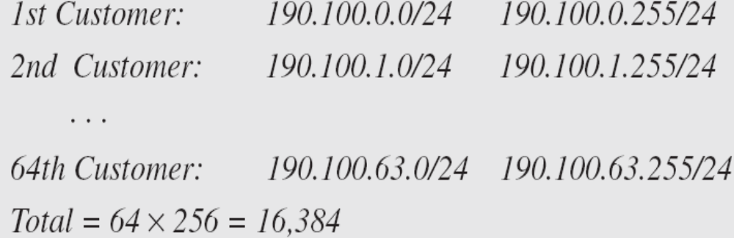
Example 19.10 (continued)
Solution
Figure 19.9 shows the situation.
Group 1
For this group, each customer needs 256 addresses. This means that 8 (log2 256) bits are needed to define each host. The prefix length is then 32 − 8 = 24. The addresses are
19.<number>

Slide 34

Example 19.10 (continued)
Group 2
For this group, each customer needs 128 addresses. This means that 7 (log2 128) bits are needed to define each host. The prefix length is then 32 − 7 = 25. The addresses are
19.<number>

Slide 35

Example 19.10 (continued)
Group 3
For this group, each customer needs 64 addresses. This means that 6 (log₂64) bits are needed to each host. The prefix length is then 32 − 6 = 26. The addresses are
Number of granted addresses to the ISP: 65,536
Number of allocated addresses by the ISP: 40,960
Number of available addresses: 24,576
19.<number>

Slide 36

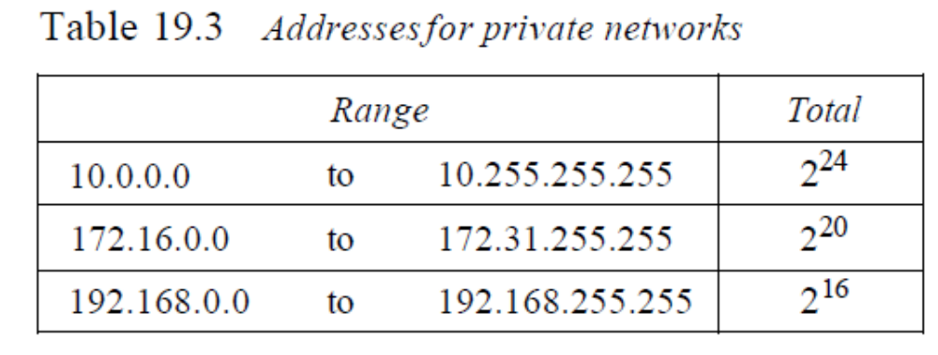
Figure 19.10 A NAT implementation
19.<number>

Slide 37

Figure 19.11 Addresses in a NAT
19.<number>

Slide 38

Figure 19.12 NAT address translation
19.<number>

Slide 39

Table 19.4 Five-column translation table
19.<number>

Slide 40
19-2 IPv6 ADDRESSES
Despite all short-term solutions, address depletion is still a long-term problem for the Internet. This and other problems in the IP protocol itself have been the motivation for IPv6.
Topics discussed in this section:
Structure
Address Space
19.<number>

Slide 41
Note
An IPv6 address is 128 bits long.
19.<number>

Slide 42

Figure 19.14 IPv6 address in binary and hexadecimal colon notation
19.<number>

Slide 43

Figure 19.15 Abbreviated IPv6 addresses
19.<number>

Slide 44

Example 19.11
Expand the address 0:15::1:12:1213 to its original.
Solution
We first need to align the left side of the double colon to the left of the original pattern and the right side of the double colon to the right of the original pattern to find how many 0s we need to replace the double colon.
This means that the original address is.
19.<number>

Slide 45
IPv4 Addressing Concepts and Their IPv6 Equivalents
IPv4 Address | IPv6 Address
Address Length – 32 bits | 128 bits
Address Representation - decimal | hexadecimal
Internet address classes | Not applicable in IPv6
Multicast addresses (224.0.0.0/4) | IPv6 multicast addresses (FF00::/8)
Broadcast addresses | Not applicable in IPv6
Unspecified address is 0.0.0.0 | Unspecified address is ::
Loopback address is 127.0.0.1 | Loopback address is ::1
Public IP addresses | Global unicast addresses
Private IP addresses (10.0.0.0/8, 172.16.0.0/12, and 192.168.0.0/16) | Site-local addresses (FEC0::/10)
Autoconfigured addresses (169.254.0.0/16) | Link-local addresses (FE80::/64)
IPv6 Packet Format

Slide 46
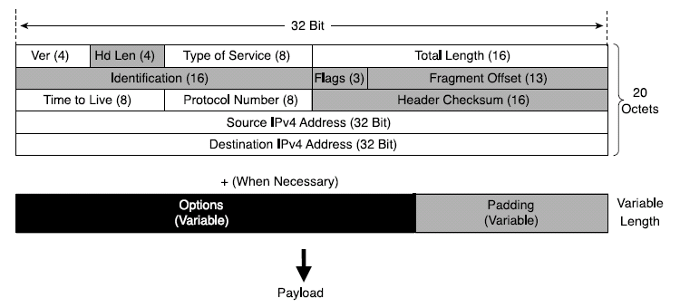
IPv4 Header Structure
basic IPv4 header contains 12 fields.
each field of the IPv4 header has a specific use.
Shaded field are removed in IPv6.
Notes:
Version (4 bits)--Represents the version of the IP protocol. In this case, the field is set to 4.
Header Length (4 bits)--The length in octets of the packet header.
Type of Service (ToS) (8 bits)--This field carries information that enables routers to classify and forward packet in a differentiated manner. It is an important service identifier used in implementing quality of service (QoS).
Total Length (16 bits)The length in octets of the entire packet, header plus payload. With 16 bits available in this field, the maximum length of an IPv4 packet is 65,535 octets.
Identification (16 bits), Flags (3 bits), Fragment Offset (13 bits)--These three fields enable IPv4 networks to support packet fragmentation to negotiate forwarding over links supporting various maximum transmission units (MTUs). Fragmentation is done as needed by the routers along the path of the packet.
Time To Live (8 bits)--It is important to protect a network's resources from packets that loop due to routing problems. This field is used to count down the number of routers that switched the packet. The packet is discarded when the value of this field is 0.
Protocol Number (8 bits)--The Protocol Number lists the upper- layer protocol (TCP, UDP, ICMP, and so on) that is present in the packet payload. The numbers that represent these protocols are assigned by IANA (http://www.iana.org/assignments/protocol- numbers).
Header Checksum (16 bits)--The integrity of the packet header is verified by comparing the computed checksum with the value listed in this field.
Source IPv4 Address (32 bits)--The IPv4 address of the node that sourced the packet.
Destination IPv4 Address (32 bits)--The IPv4 address of the packet destination node.
Options (variable length)--This field is meant as a placeholder for the information relevant to proper handling of the data carried by the packet, information that is not represented in the other fields of the header. Because of this field, the IPv4 header has a variable length, justifying the need for the Header Length field.
Padding (variable length)--Is used to align the variable-length Options field to the 32-bit boundary.

Slide 47
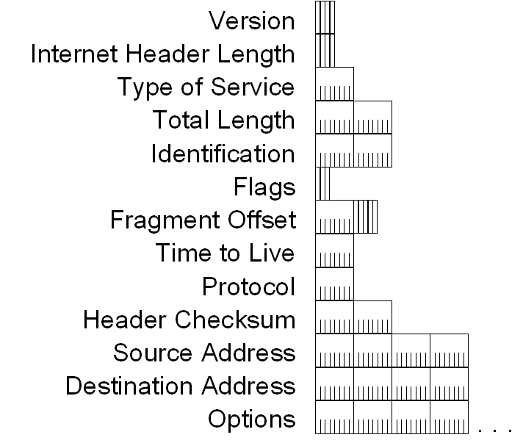
IPv4 Header - Review

Slide 48
IPv4 Header - Review
Version (4 bits)
  Indicates the version of IP and is set to 4.
Internet Header Length (4 bits)
  Indicates the number of 4-byte blocks in the IPv4 header.
  Because an IPv4 header is a minimum of 20 bytes in size, the smallest value of the Internet Header Length (IHL) field is 5.
Type of Service (4 bits)
  Indicates the desired service expected by this packet for delivery through routers across the IPv4 internetwork.
IPv6 Packet Format

Slide 49
IPv4 Header - Review
Total Length (16 bits)
  Indicates the total length of the IPv4 packet (IPv4 header + IPv4 payload) and does not include link layer framing.
Identification (16 bits)
  Identifies this specific IPv4 packet.
  The Identification field is selected by the originating source of the IPv4 packet. If the IPv4 packet is fragmented, all of the fragments retain the Identification field value so that the destination node can group the fragments for reassembly.
Flags (3 bits)
  Identifies flags for the fragmentation process.
  There are two flags—one to indicate whether the IPv4 packet might be fragmented and another to indicate whether more fragments follow the current fragment.
Fragment Offset (13 bits)
  Indicates the position of the fragment relative to the original IPv4 payload.
IPv6 Packet Format

Slide 50
IPv4 Header - Review
Time to Live ( 8 bits)
  Indicate the maximum number of links on which an IPv4 packet can travel before being discarded.
  Originally used as a time count with which an IPv4 router determined the length of time required (in seconds) to forward the IPv4 packet, decrementing the TTL accordingly. When the TTL equals 0,an ICMP Time Expired-TTL Expired in Transit message is sent to the source IPv4 address and the packet is discarded.
Protocol (8 bits)
  Identifies the upper layer protocol.
  For example, TCP uses a Protocol of 6, UDP uses a Protocol of 17, and ICMP uses a Protocol of 1.
  The Protocol field is used to demultiplex an IPv4 packet to the upper layer protocol.
IPv6 Packet Format

Slide 51
IPv4 Header - Review
Header Checksum (16 Bits)
  Provides a checksum on the IPv4 header only.
  The IPv4 payload is not included in the checksum calculation as the IPv4 payload and usually contains its own checksum..
Source Address ( 32 bits)
  Stores the IPv4 address of the originating host.
Destination Address (32 bits)
  Stores the IPv4 address of the destination host.
Options (multiple of 32 bits)
  Stores one or more IPv4 options.
IPv6 Packet Format

Slide 52
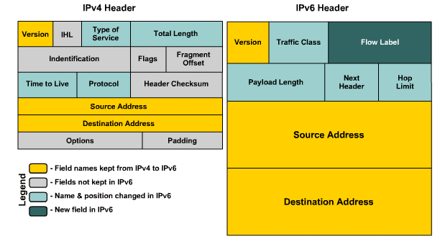
IPv4 vs IPv6 Header
IPv6 Packet Format

Slide 53
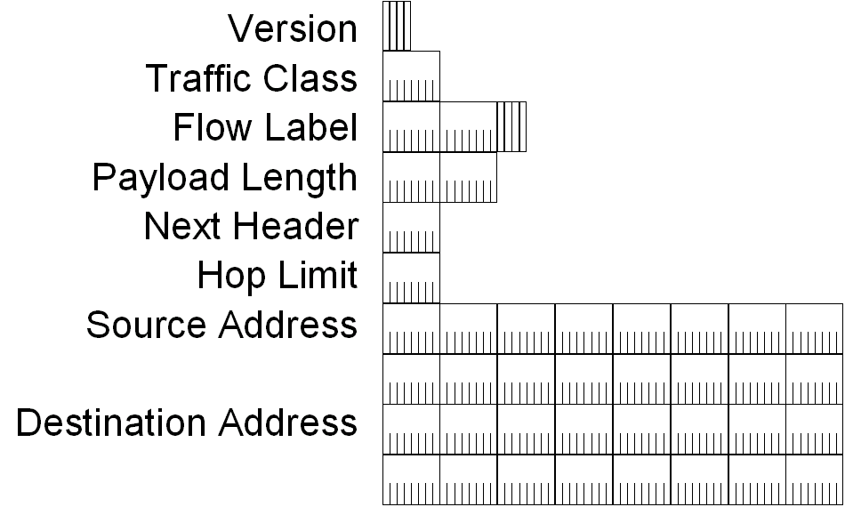
IPv6 Header
IPv6 Packet Format

Slide 54
IPv6 Header Fields
Based on these rules, RFC 2460 defines the following IPv6 header fields:
  Version (4 bits)
    4 bits are used to indicate the version of IP and is set to 6
  Traffic Class (8 bits)
    same function as the Type of Service field in the IPv4 header.
  Flow Label (20 bits)
    identifies a flow and it is intended to enable the router to identify packets that should be treated in a similar way without the need for deep lookups within those packets.
    set by the source and should not be changed by routers along the path to destination.

Slide 55
IPv6 Header Fields
Payload Length (16 bits)
  With the header length fixed at 40 bytes, it is enough to indicate the length of the payload to determine the length of the entire packet.
Next Header (8 bits)
  Indicates either the first extension header (if present) or the protocol in the upper layer PDU (such as TCP, UDP, or ICMPv6).
Hop Limit (8 bits)
  In IPv6, the IPv4 TTL was appropriately renamed Hop Limit because it is a variable that is decremented at each hop, and it does not have a temporal dimension.
IPv6 Packet Format

Slide 56
IPv6 Header Fields
Source IPv6 Address (128 bits)
  Stores the IPv6 address of the originating host.
Destination IPv6 Address (128 bits)
  Stores the IPv6 address of the current destination host.
IPv6 Packet Format

Slide 57
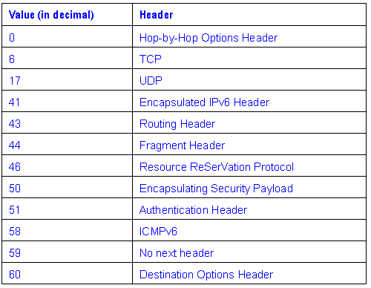
Values of the Next Header Field
IPv6 Packet Format

